Slide 1
PythonDS-10 Tuple Data Structure and its Methods
Dr. Naveen Kumar
Associate Professor
Amity Institute of Information Technology
Amity University Patna

Slide 2
Python Tuple
A Python tuple is an ordered, immutable collection of elements, defined by enclosing items in parentheses () and separating them with commas.
Tuples are faster and more memory-efficient than lists for fixed data, and are commonly used for data that should not be changed, such as coordinates or database records.

Slide 3
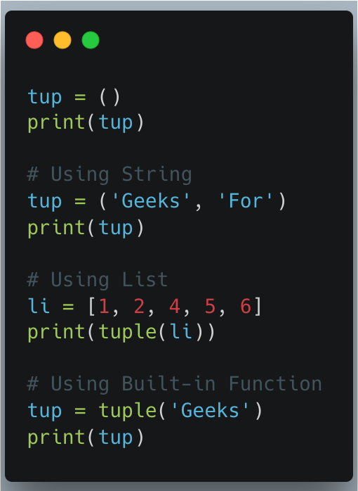

Slide 4
Key Characteristics
Ordered: Items have a defined, unchangeable order, allowing access by index.
Immutable (Unchangeable): Once a tuple is created, you cannot change, add, or remove elements. Attempting to modify a tuple will raise a TypeError.
Allow Duplicates: Because tuples are indexed, they can contain multiple items with the same value.
Heterogeneous: A single tuple can store elements of different data types (strings, integers, floats, lists, etc.).
Iterable: You can loop through the elements of a tuple.
Hashable: If all elements within a tuple are immutable, the tuple itself is hashable and can be used as a key in a dictionary.

Slide 5
Tuple is Immutable
Unlike Python lists, tuples are immutable. Some Characteristics of Tuples in Python.
Like Lists, tuples are ordered and we can access their elements using their index values
We cannot update items to a tuple once it is created.
Tuples cannot be appended or extended.
We cannot remove items from a tuple once it is created.

Slide 6
Creating Tuples
Tuples can be created in several ways:
Using parentheses: The most common way.
my_tuple = ("apple", "banana", "cherry")
Without parentheses (Tuple Packing):
my_tuple = 1, 2, 3
Single-element tuple: A trailing comma is required to differentiate it from a single value in parentheses.
single_item_tuple = ("apple",) # a tuple
not_a_tuple = ("apple") # a string
Using the tuple() constructor: Converts an iterable (like a list or string) into a tuple.
list_to_tuple = tuple(["apple", "banana"])
string_to_tuple = tuple("hello")

Slide 7
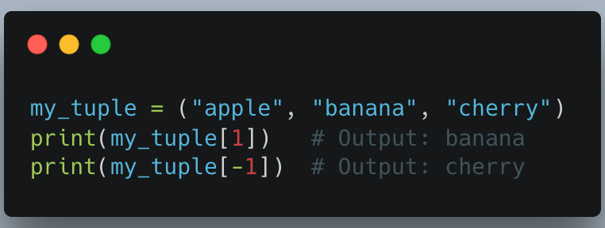
Operations and Methods
Tuples support standard sequence operations:
Indexing: Access individual elements using square brackets [] and a zero-based index. Negative indexing is also supported to access elements from the end.

Slide 8
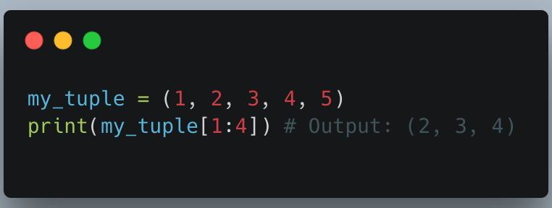
Slicing: Extract a range of elements to create a new tuple.

Slide 9
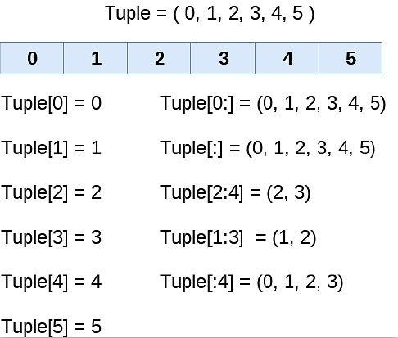

Slide 10
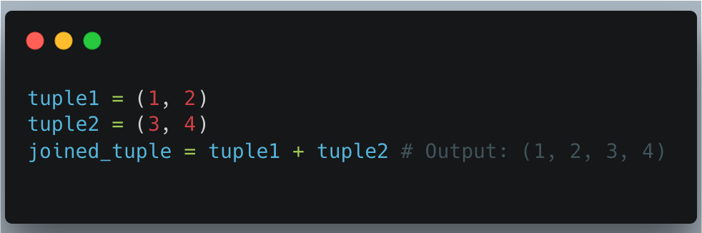
Concatenation: Join two or more tuples using the + operator to create a new tuple.

Slide 11
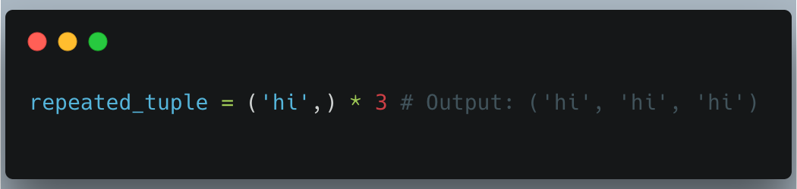
Repetition: Use the * operator to repeat a tuple's contents.

Slide 12
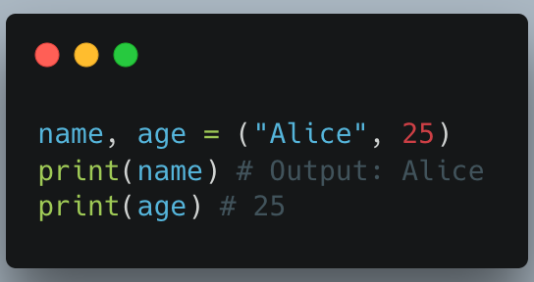
Unpacking: Assign elements of a tuple to multiple variables in a single line.

Slide 13
Only two built-in Methods
Tuples have only two built-in methods due to their immutability:
count(value): Returns the number of times a specified value appears.
index(value): Returns the index of the first occurrence of a specified value, raising an error if not found.
When to Use Tuples
Fixed Data: Ideal for data that should remain constant throughout the program, like configuration settings, calendar days, or geographic coordinates.
Function Returns: Functions often return multiple values as a tuple, which can then be easily unpacked.
Dictionary Keys: Usable as dictionary keys (provided all their elements are immutable), unlike lists.
Performance: Slightly faster and more memory-efficient than lists for large, fixed data sets.

Slide 14
Built-in Function | Description
all() | Returns true if all element are true or if tuple is empty
any() | return true if any element of the tuple is true. if tuple is empty, return false
len() | Returns length of the tuple or size of the tuple
enumerate() | Returns enumerate object of tuple
max() | return maximum element of given tuple
min() | return minimum element of given tuple
sum() | Sums up the numbers in the tuple
sorted() | input elements in the tuple and return a new sorted list
tuple() | Convert an iterable to a tuple.

Slide 15
all() function returns true if all the elements of a given iterable (List, Dictionary, Tuple, set, etc.) are True otherwise it returns False.
It also returns True if the iterable object is empty.
Sometimes while working on some code if we want to ensure that user has not entered a False value then we use the all() function.
print(all([True, True, False]))

Slide 16
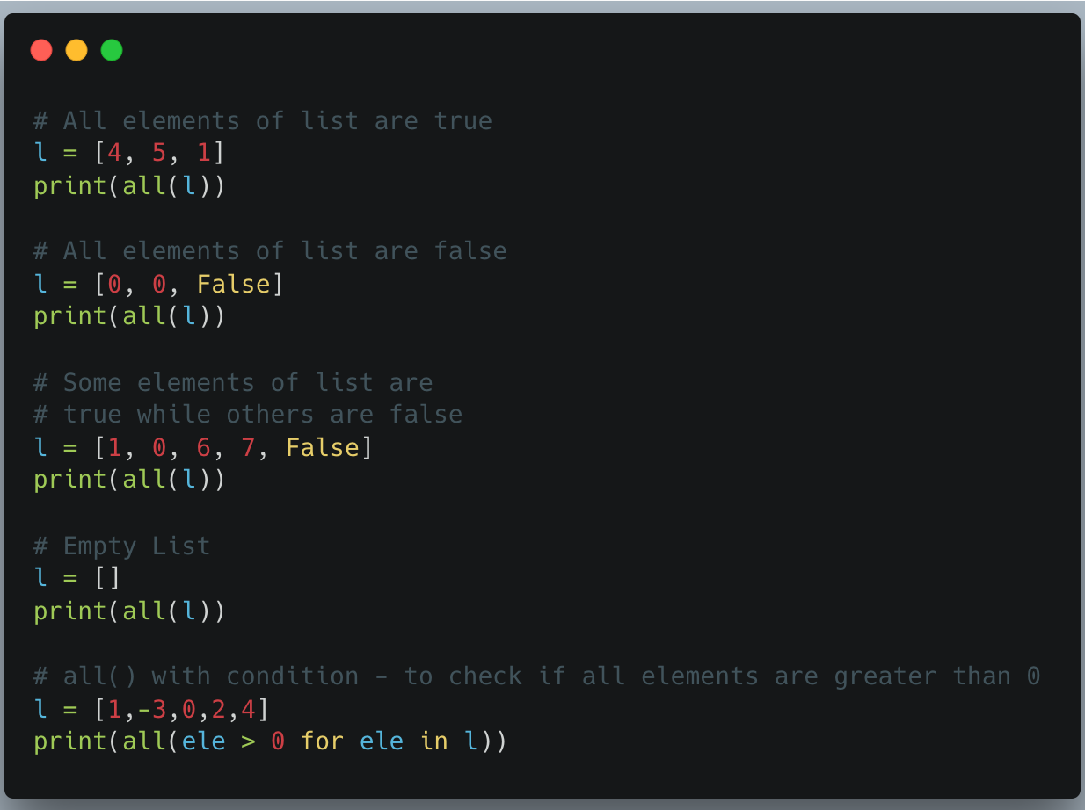
all() with list

Slide 17
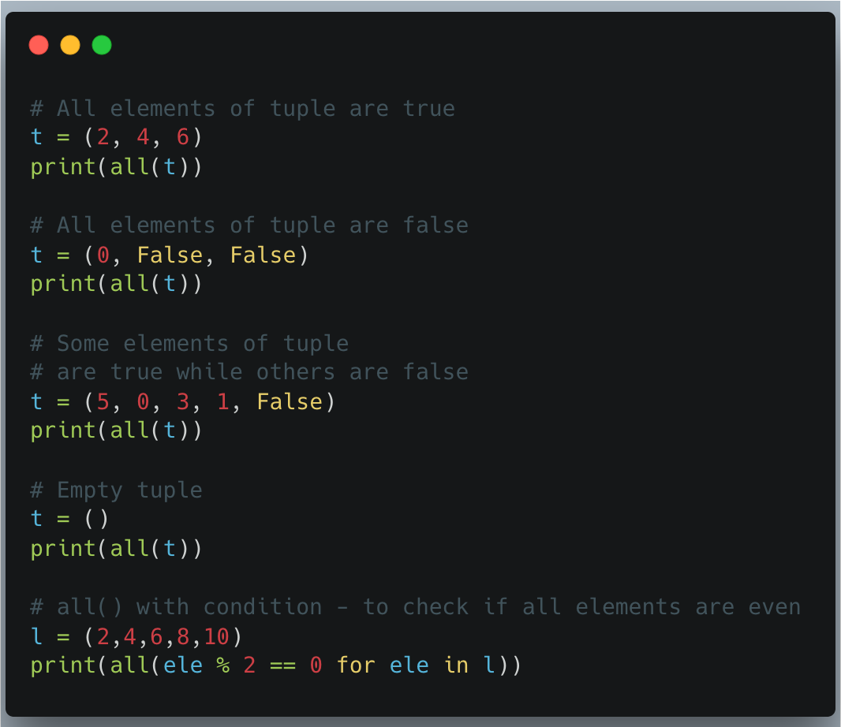
all() with tuple

Slide 18
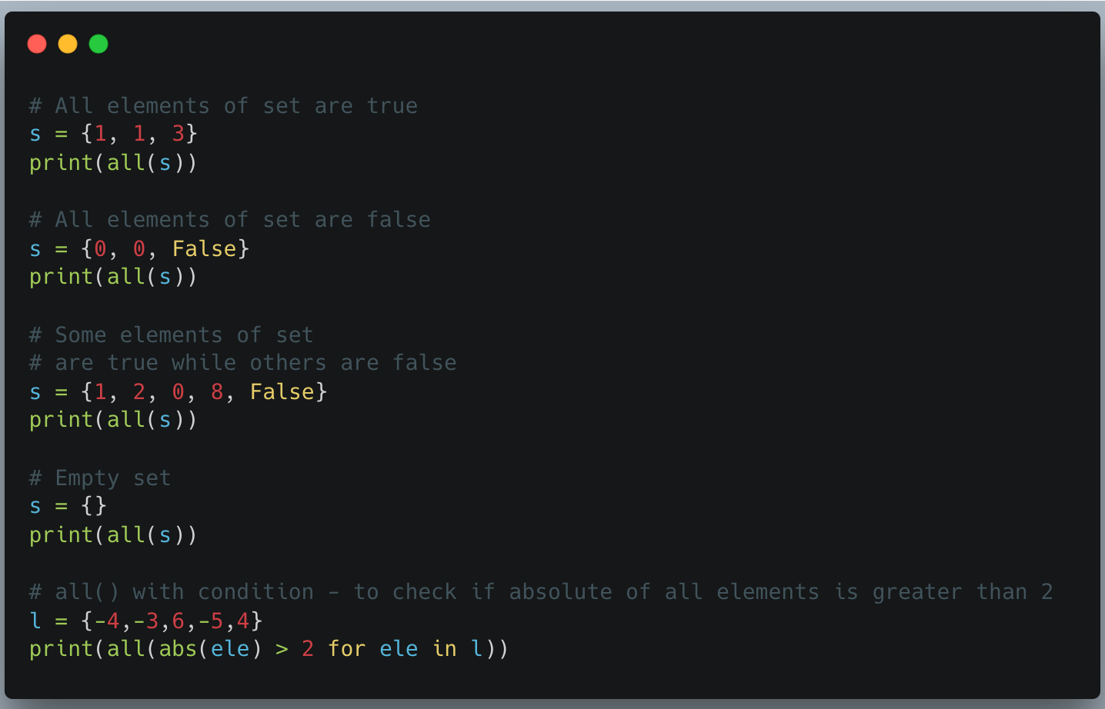
all() with Set

Slide 19
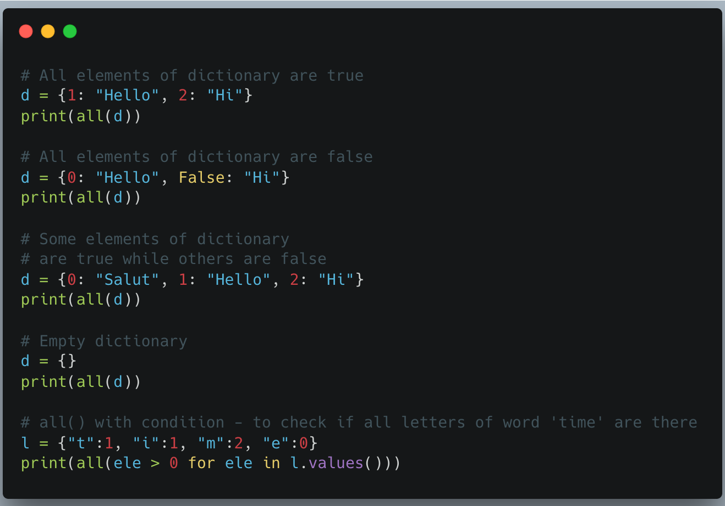
all with Dictionary

Slide 20
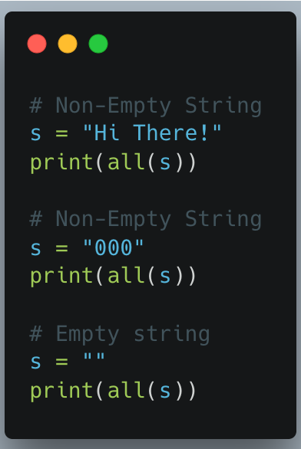
all() with string

Slide 21
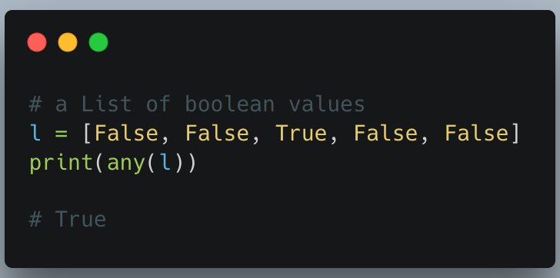
any() function
Python any() function returns True if any of the elements of a given iterable( List, Dictionary, Tuple, set, etc) are True else it returns False.

Slide 22
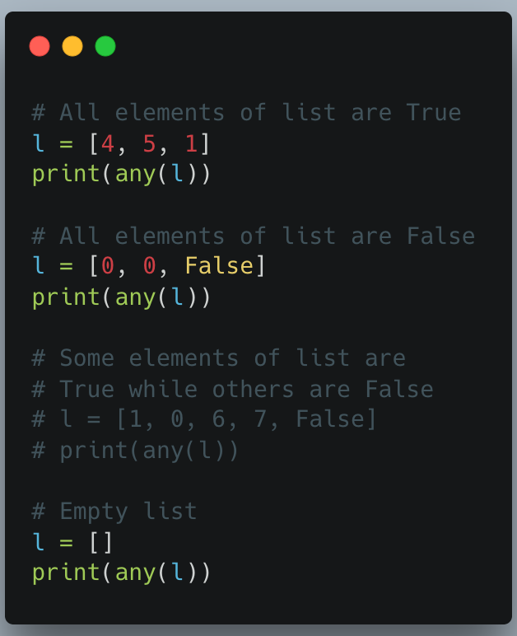

Slide 23
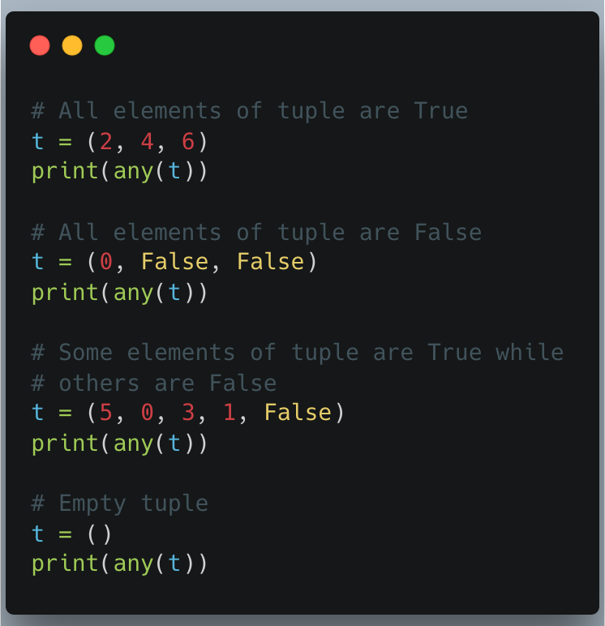

Slide 24
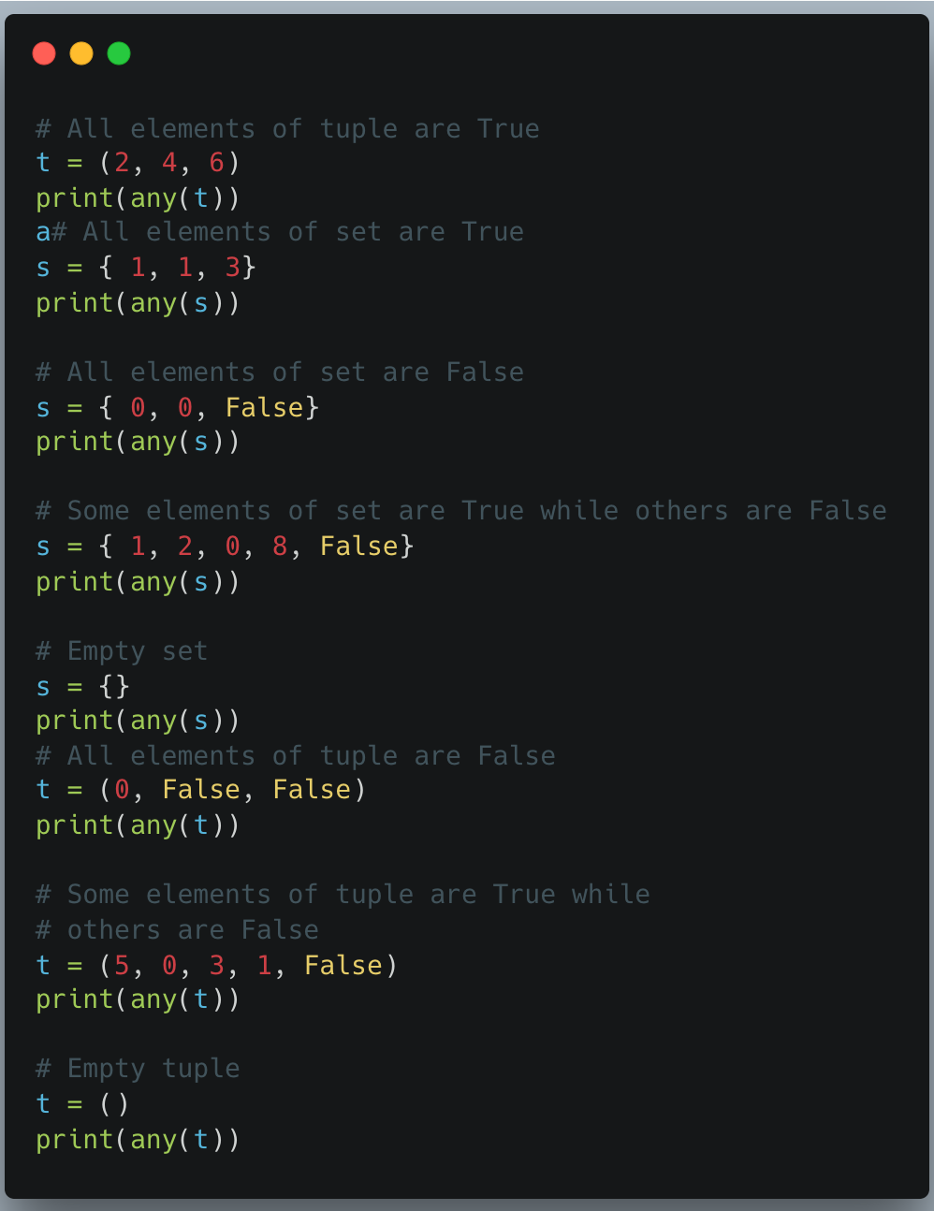

Slide 25
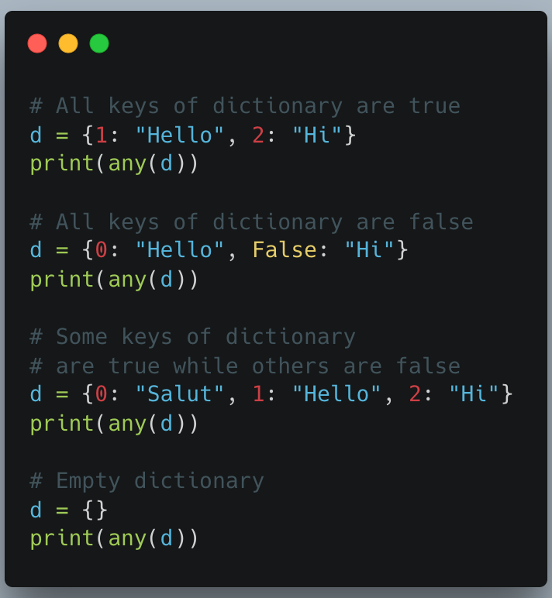

Slide 26
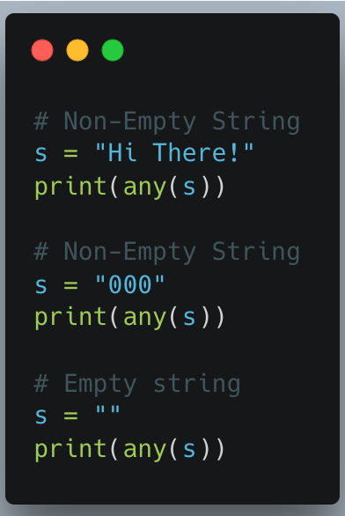

Slide 27
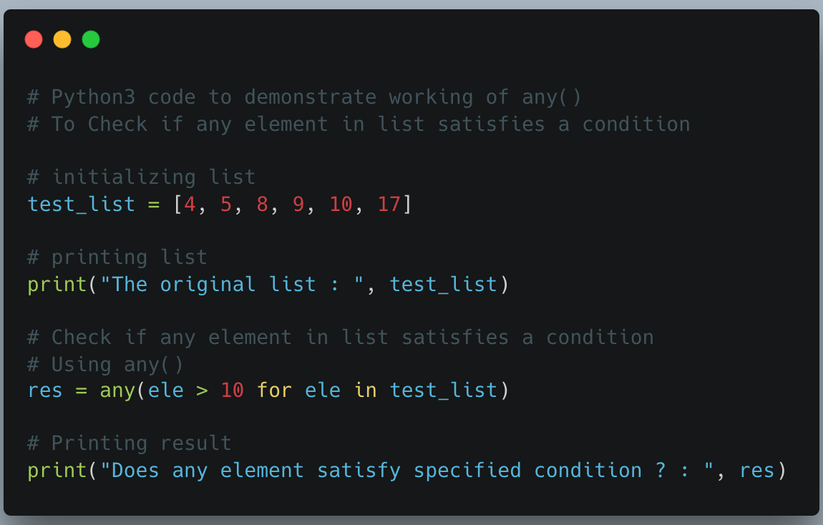

Slide 28
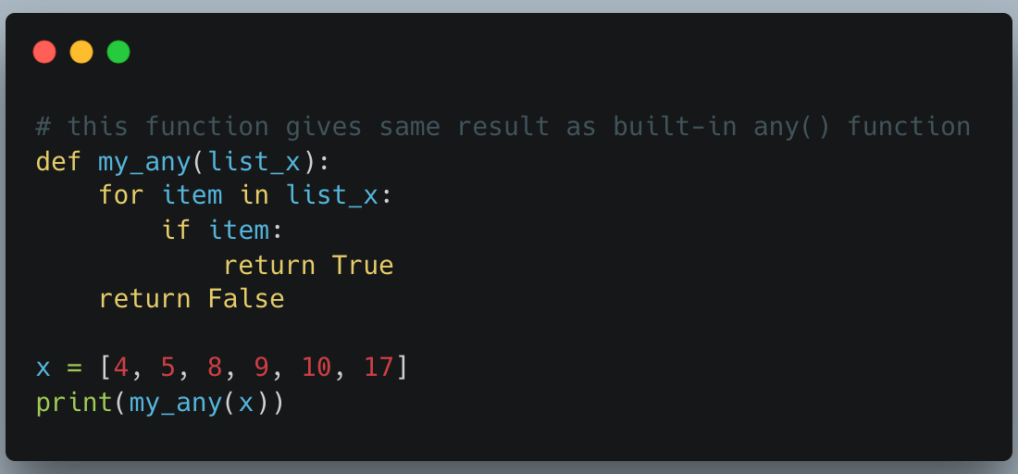

Slide 29
enumerate() function
enumerate() function adds a counter to each item in a list or any other iterable, and returns a list of tuples containing the index position and the element for each element of the iterable.
It turns the iterable into something we can loop through using indexes, where each item comes with its number (starting from 0 by default).

Slide 30
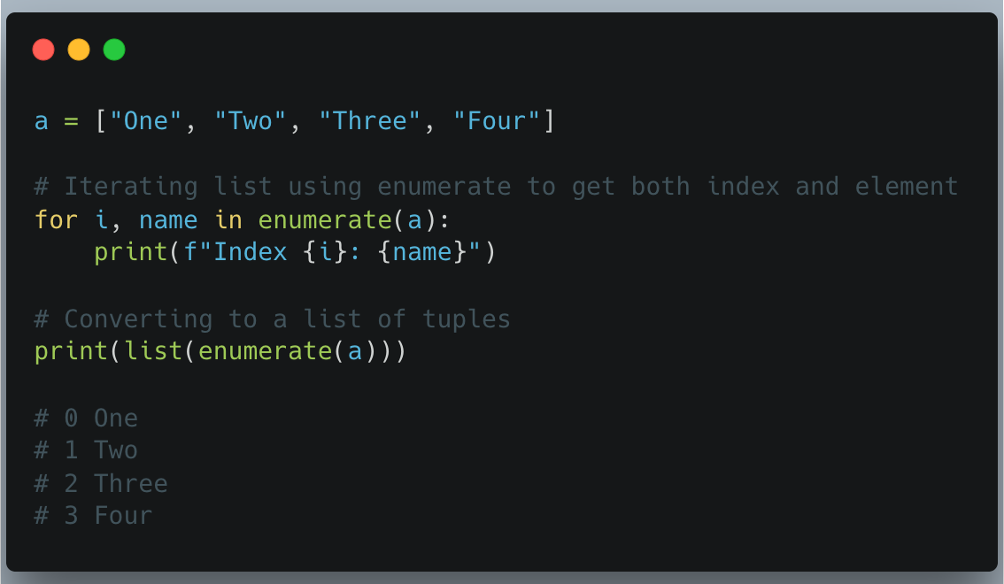
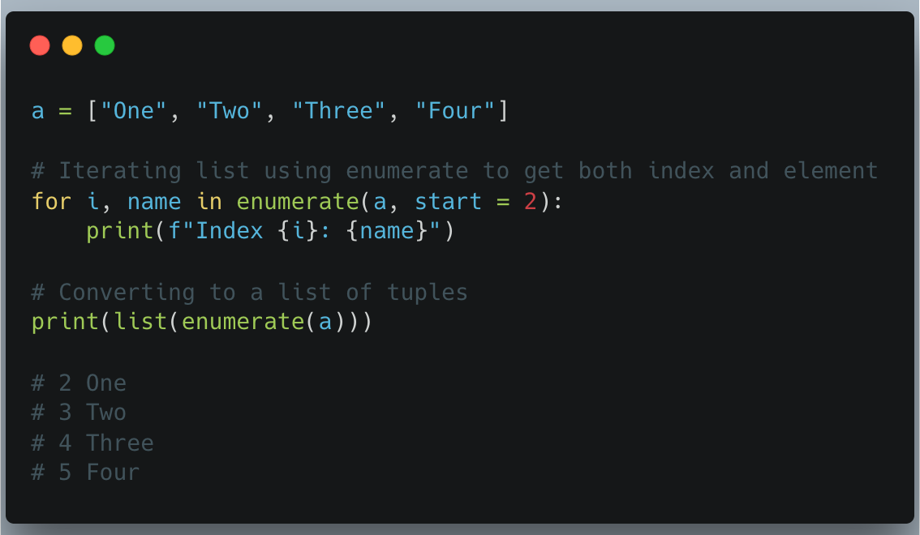

Slide 31
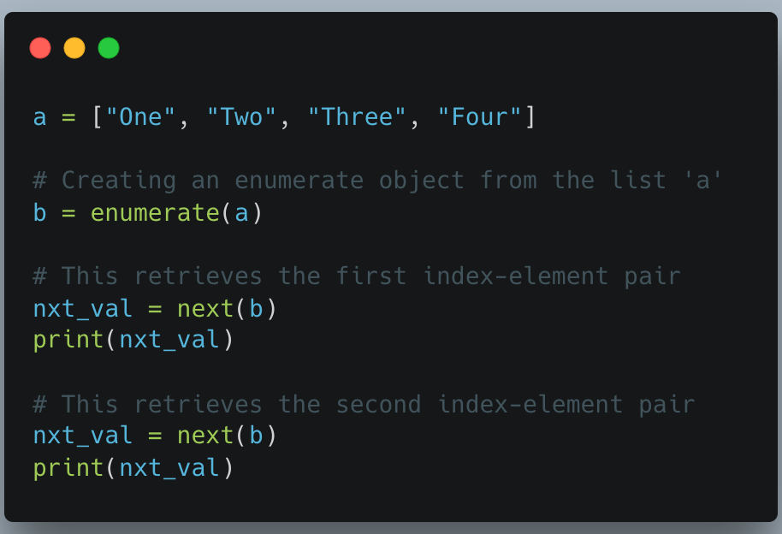

Slide 32
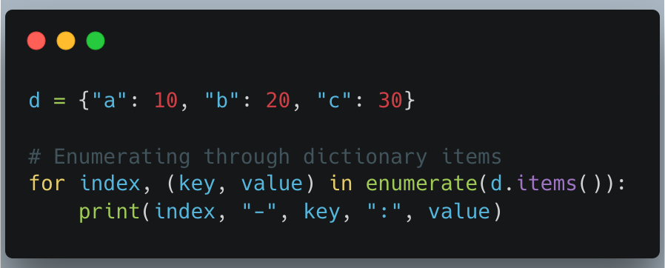
Enumerating a Dictionary

Slide 33
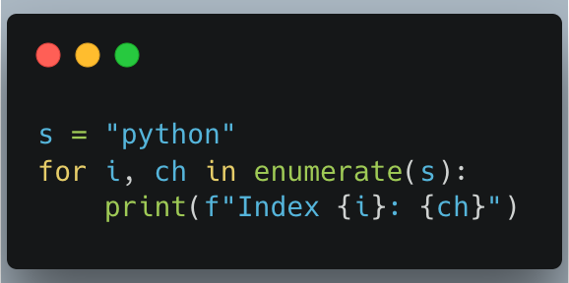
Enumerating a String

Slide 34
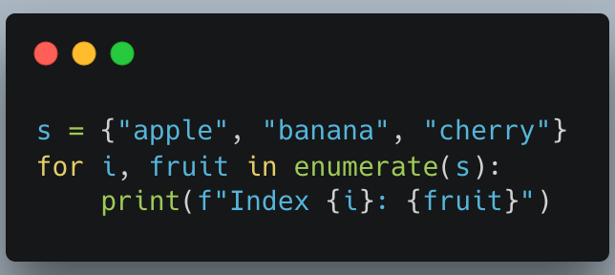
Enumerating a Sets

Slide 35
Python max() function With Objects
Unlike the max() function of C/C++, the max() function in Python can take any type of object and return the largest among them. In the case of strings, it returns the lexicographically largest value.
Syntax : max(arg1, arg2, *args[, key])
Parameters :
arg1, arg2 : objects of the same datatype
*args : multiple objects
key : function where comparison of iterable is performed based on its return value
Returns : The maximum value

Slide 36
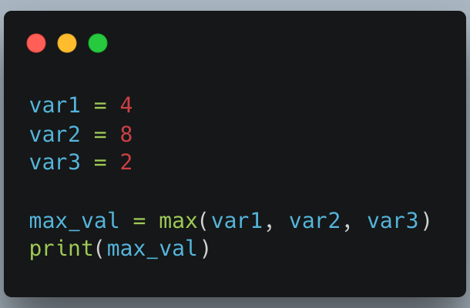

Slide 37
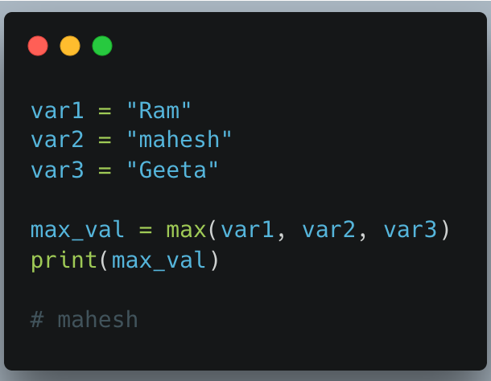

Slide 38
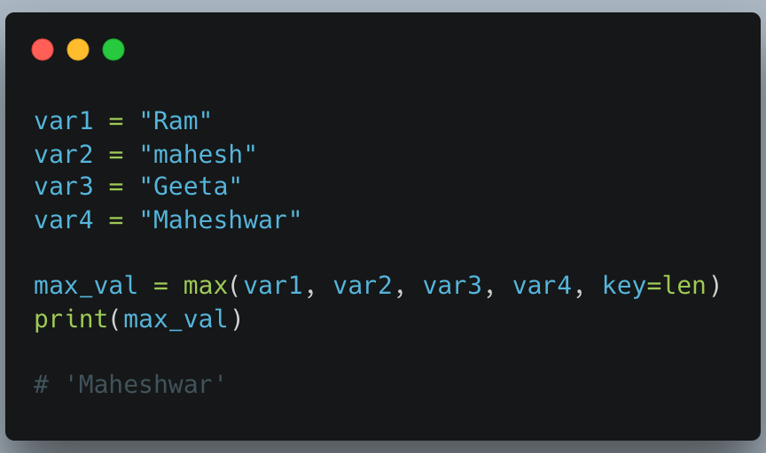

Slide 39
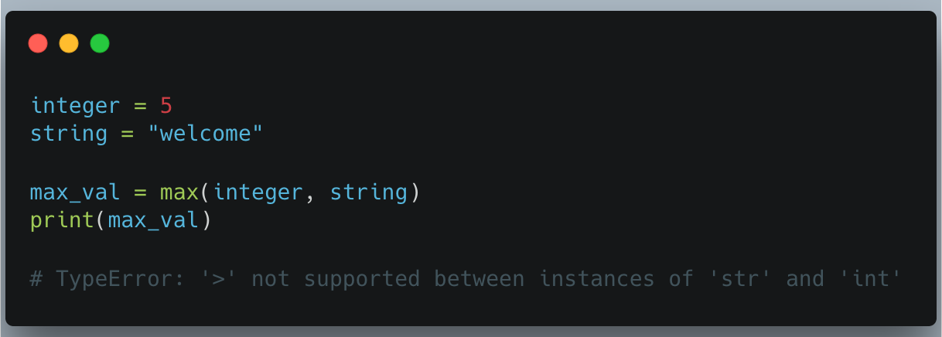

Slide 40
min() function
Python min() function returns the smallest value from a set of values or the smallest item in an iterable passed as its parameter. It's useful when you need to quickly determine the minimum value from a group of numbers or objects. For example:
Python min() function syntax
min(iterable, *[, key, default])
Parameters:
iterable: A sequence like a list, tuple or string.
key (optional): A function to determine how elements are compared.
default (optional): Value to return if the iterable is empty.
Return Value: It returns the smallest item from the iterable. If key is used, it returns the smallest based on that function. If the iterable is empty and default is provided, it returns the default value.

Slide 41
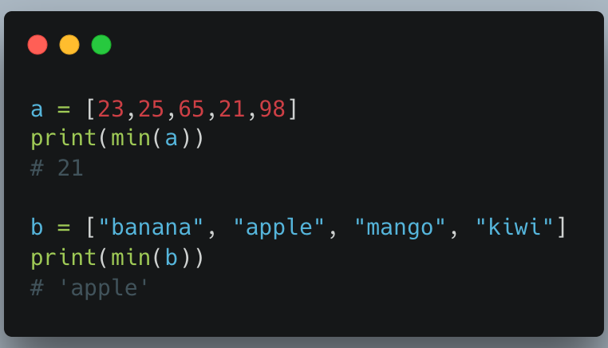

Slide 42
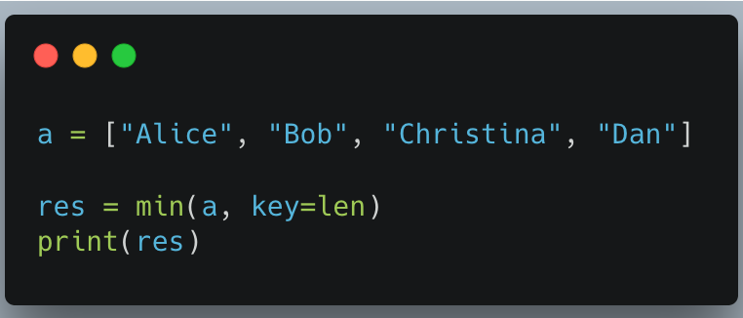

Slide 43
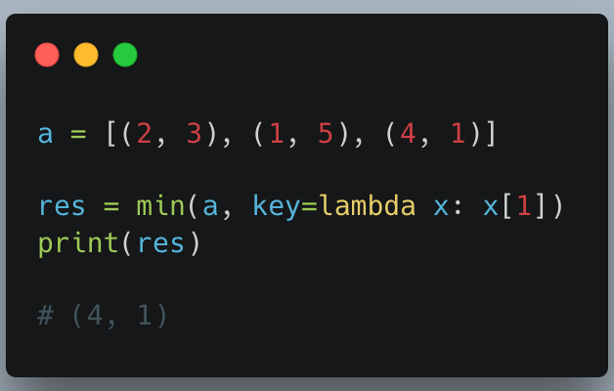
Explanation: key=lambda x: x[1] compares the tuples based on their second item. In the tuples (2, 3), (1, 5) and (4, 1), the second items are 3, 5 and 1, respectively. Since 1 is the smallest, the tuple (4, 1) is returned.

Slide 44
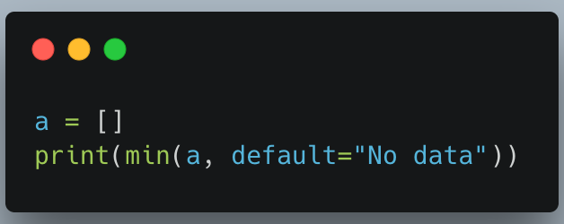

Slide 45
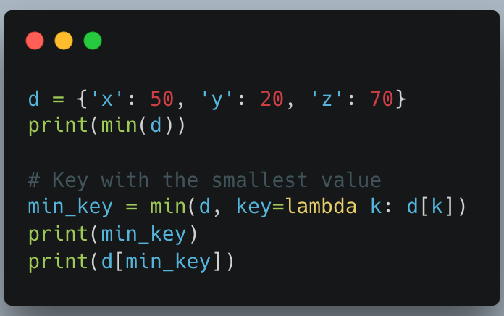

Slide 46
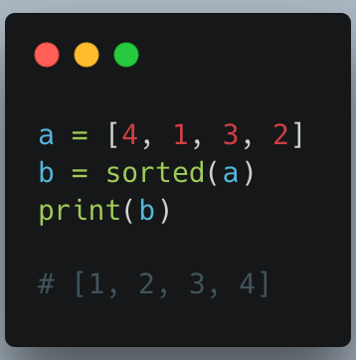
sorted() function
sorted() function in Python returns a new sorted list from the elements of any iterable, such as a list, tuple, set, or string. It does not modify the original iterable, unlike the sort() method for lists.

Slide 47
Syntax
sorted(iterable, key=None, reverse=False)
Parameters:
iterable: The sequence to be sorted (list, tuple, set, string, etc.)
key (Optional): A function to customize the sort order. Default is None.
reverse (Optional): If True, sorts in descending order. Default is False.
Return Type: Returns a new sorted list containing all elements from the iterable according to the given criteria.

Slide 48
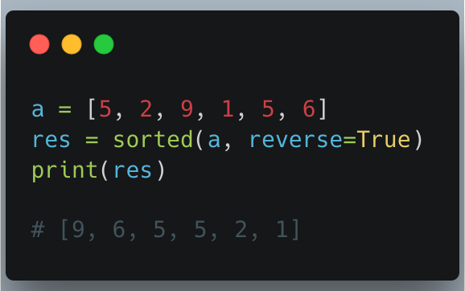
Sorting in Descending Order
To sort an iterable in descending order, set the reverse argument to True.

Slide 49
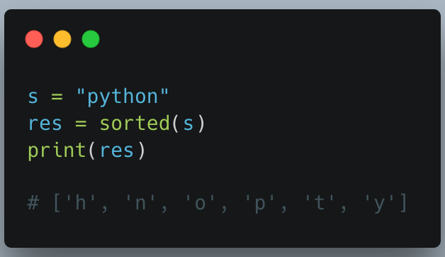

Slide 50
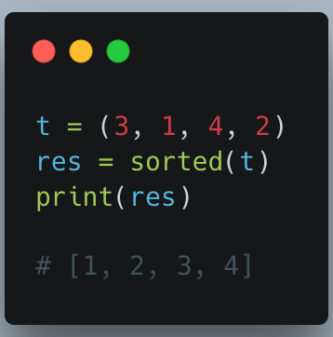

Slide 51
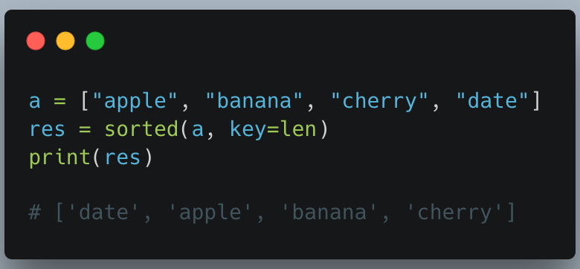
Sorting using key Parameter
The key parameter is an optional argument that allows us to customize the sort order.
1. Sorting Strings by Length: You can sort a list of strings by their length using the key=len parameter in sorted().

Slide 52
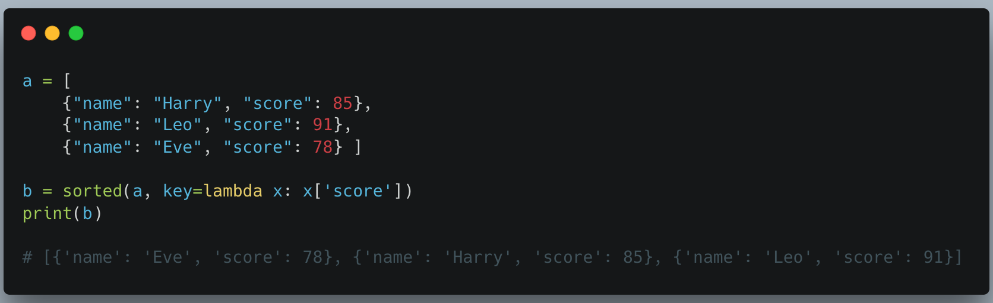
2. Sorting a List of Dictionaries: You can sort a list of dictionaries based on a specific key using sorted() with a lambda function.

Slide 53
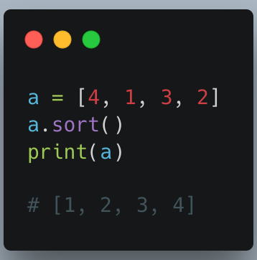
sort() vs sorted()
The sort() method is used to arrange the elements of a list in a specific order, either ascending or descending. It changes the original list directly, so no new list is created. This method works well for sorting numbers or strings.

Slide 54
Syntax
lst.sort(key=None, reverse=False)
Parameters:
key (optional): A function used to decide how elements are compared (for example, key=len sorts strings by length).
reverse (optional): Controls the sorting order. False (default) sorts in ascending order, True sorts in descending order.

Slide 55
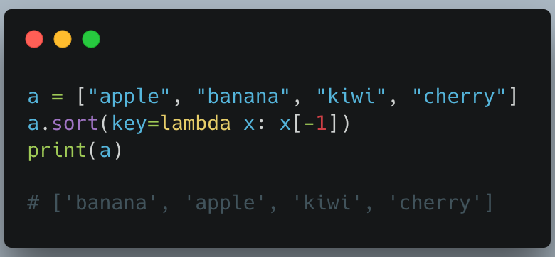
You can also define custom rules using a lambda function, such as sorting words by their last character.

Slide 56
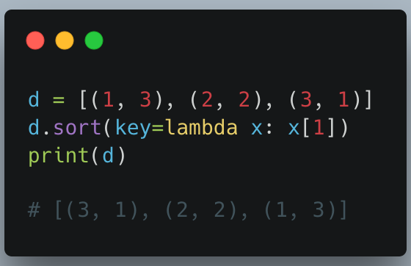
When sorting tuples, you can sort based on a specific element inside each tuple.

Slide 57
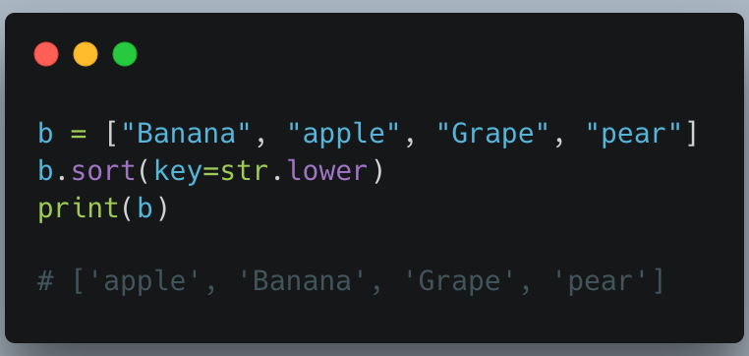
Case-Insensitive Sorting
By default, the sort() method is case sensitive, resulting in all capital letters being sorted before lowercase letters. To perform a case insensitive sort, we can use the str.lower function as the key.

Slide 58
Tuple vs List
Similarities | Differences
Functions that can be used for both lists and tuples: len(), max(), min(), sum(), any(), all(), sorted() | Methods that cannot be used for tuples: append(), insert(), remove(), pop(), clear(), sort(), reverse()
Methods that can be used for both lists and tuples: count(), Index() | we generally use 'tuples' for heterogeneous (different) data types and 'lists' for homogeneous (similar) data types.
Tuples can be stored in lists. | Iterating through a 'tuple' is faster than in a 'list'.
Lists can be stored in tuples. | 'Lists' are mutable whereas 'tuples' are immutable.
Both 'tuples' and 'lists' can be nested. | Tuples that contain immutable elements can be used as a key for a dictionary.

